Slide 1
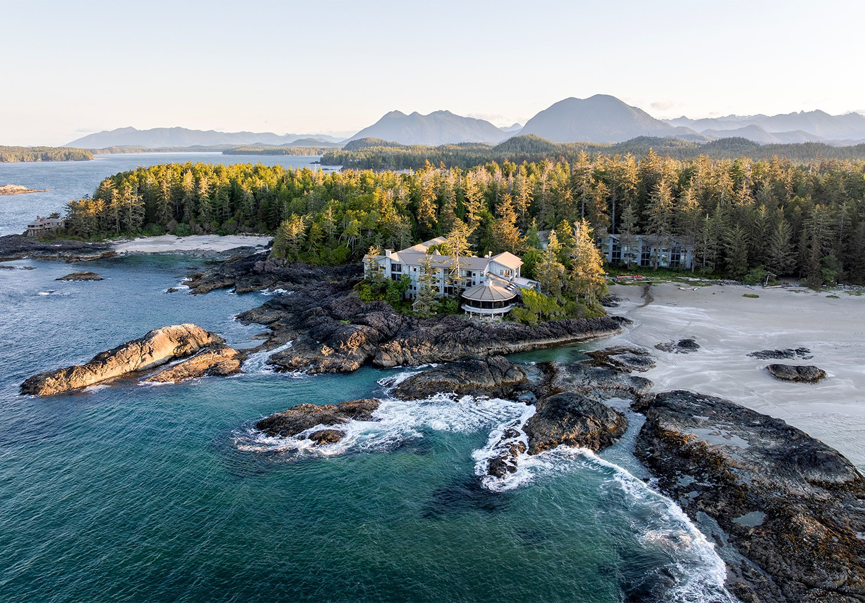

Go Places. Build Careers.
Opportunities in BC’s Hotel & Hospitality Industry
Notes:
Hello everyone, thank you for being here.
My name is [Your Name], and on behalf of the [Your Company] and the British Columbia Hotel Association, I’m excited to talk to you about the current landscape of our industry.
When people think of working in hotels or hospitality, they often think of a summer job or a temporary position.
But we're here today to talk about something much bigger: the chance to go places and build a career.
BC is home to world-class destinations, and behind every one is a network of professional opportunities.

Slide 2
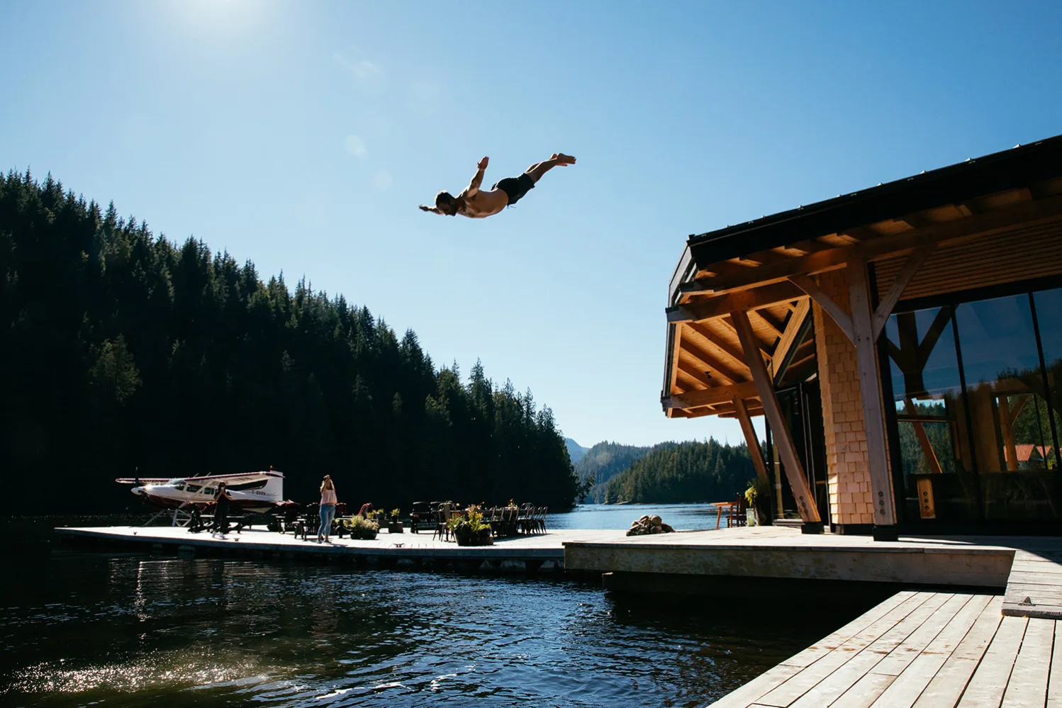
Why Hospitality?
In the Hospitality sector, there are currently
331,750
people employed in BC.
source: go2HR.ca
Notes:
KEY MESSAGE: The hospitality industry is a massive driver of British Columbia's workforce.
So, why should someone choose hospitality?
Well, if you like being part of something big, you’re in the right place.
In BC, there are over 331,000 people who wake up every day and go to work in this sector.
Whether it’s hotels, restaurants, or events, this is a thriving community.
Joining this industry means joining one of the largest networks of professionals in the province.
With a workforce this size, the diversity of roles and upward mobility are endless.

Slide 3
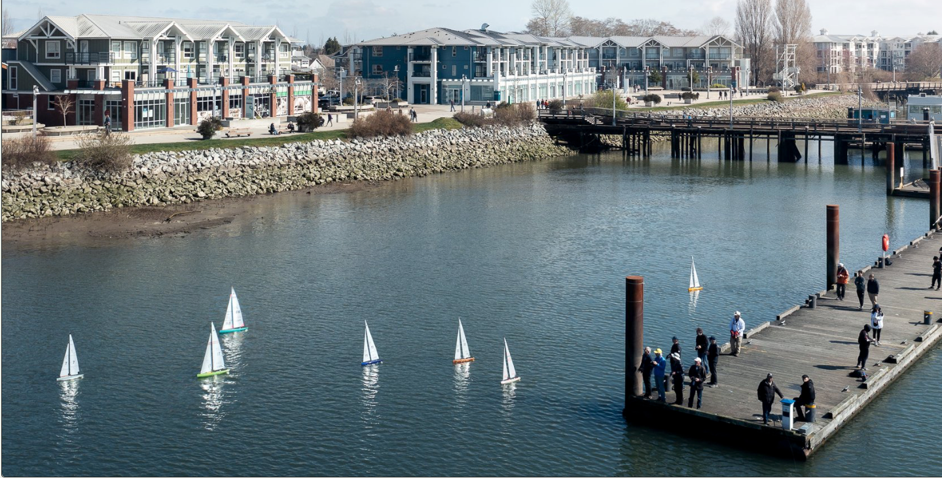
Why Hospitality?
Economic Impact
Entrepreneurial Spirit
Variety & Adventure
Make a difference in BC’s Economy
Turn Every Role Into Opportunity
Work Anywhere, Experience Everything
Working in hospitality means being part of an industry that drives billions into BC’s economy, giving your work real-world significance.
Every hotel is a small business ecosystem, so you gain hands-on experience in management, teamwork, and problem-solving across operations.
Hospitality is everything from accommodation and dining to entertainment, recreation, and travel.
go2HR.ca
Notes:
Let’s look at why this industry offers a strong career path.
First is Economic Impact. Hospitality drives billions of dollars into BC’s economy every year.
Working here means your job plays a major role in BC's financial success.
Second is Entrepreneurial Spirit. A single hotel is a complete business on its own.
By working in one, you get direct experience in management, teamwork, finance, and problem-solving across different departments.
Third is Variety and Adventure. Hospitality goes way beyond just hotels.
It includes restaurants, entertainment, recreation, and travel. It gives you the flexibility to work in different roles and locations all over BC.

Slide 4
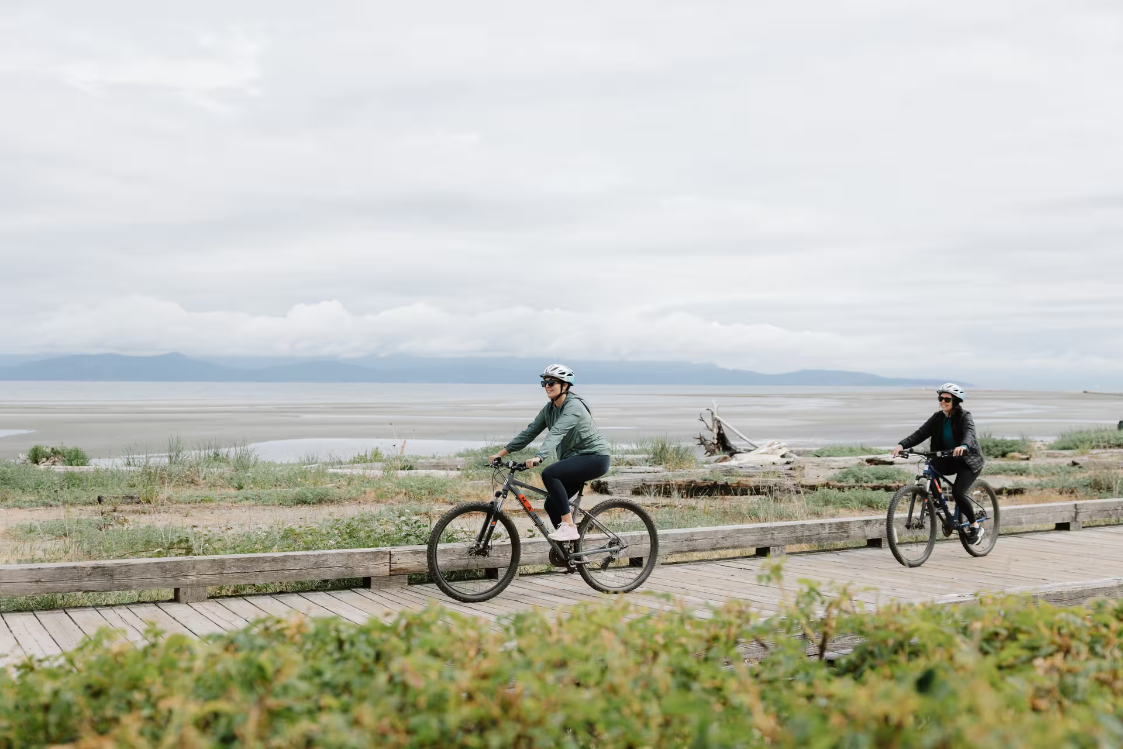
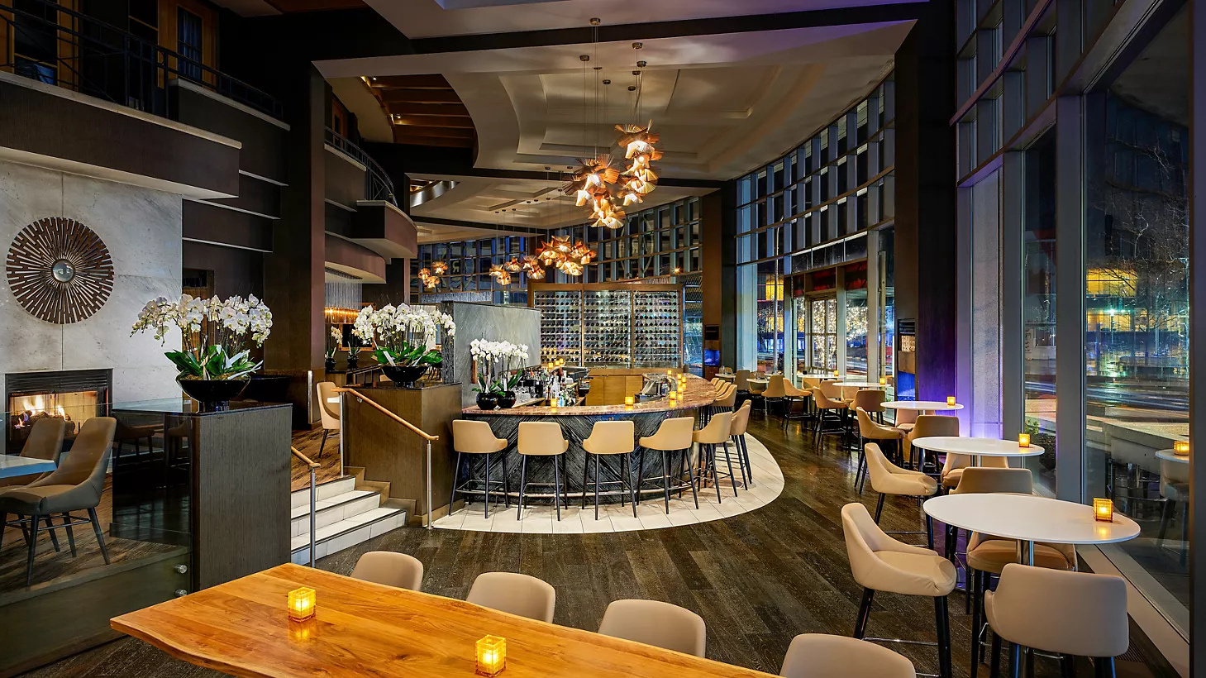
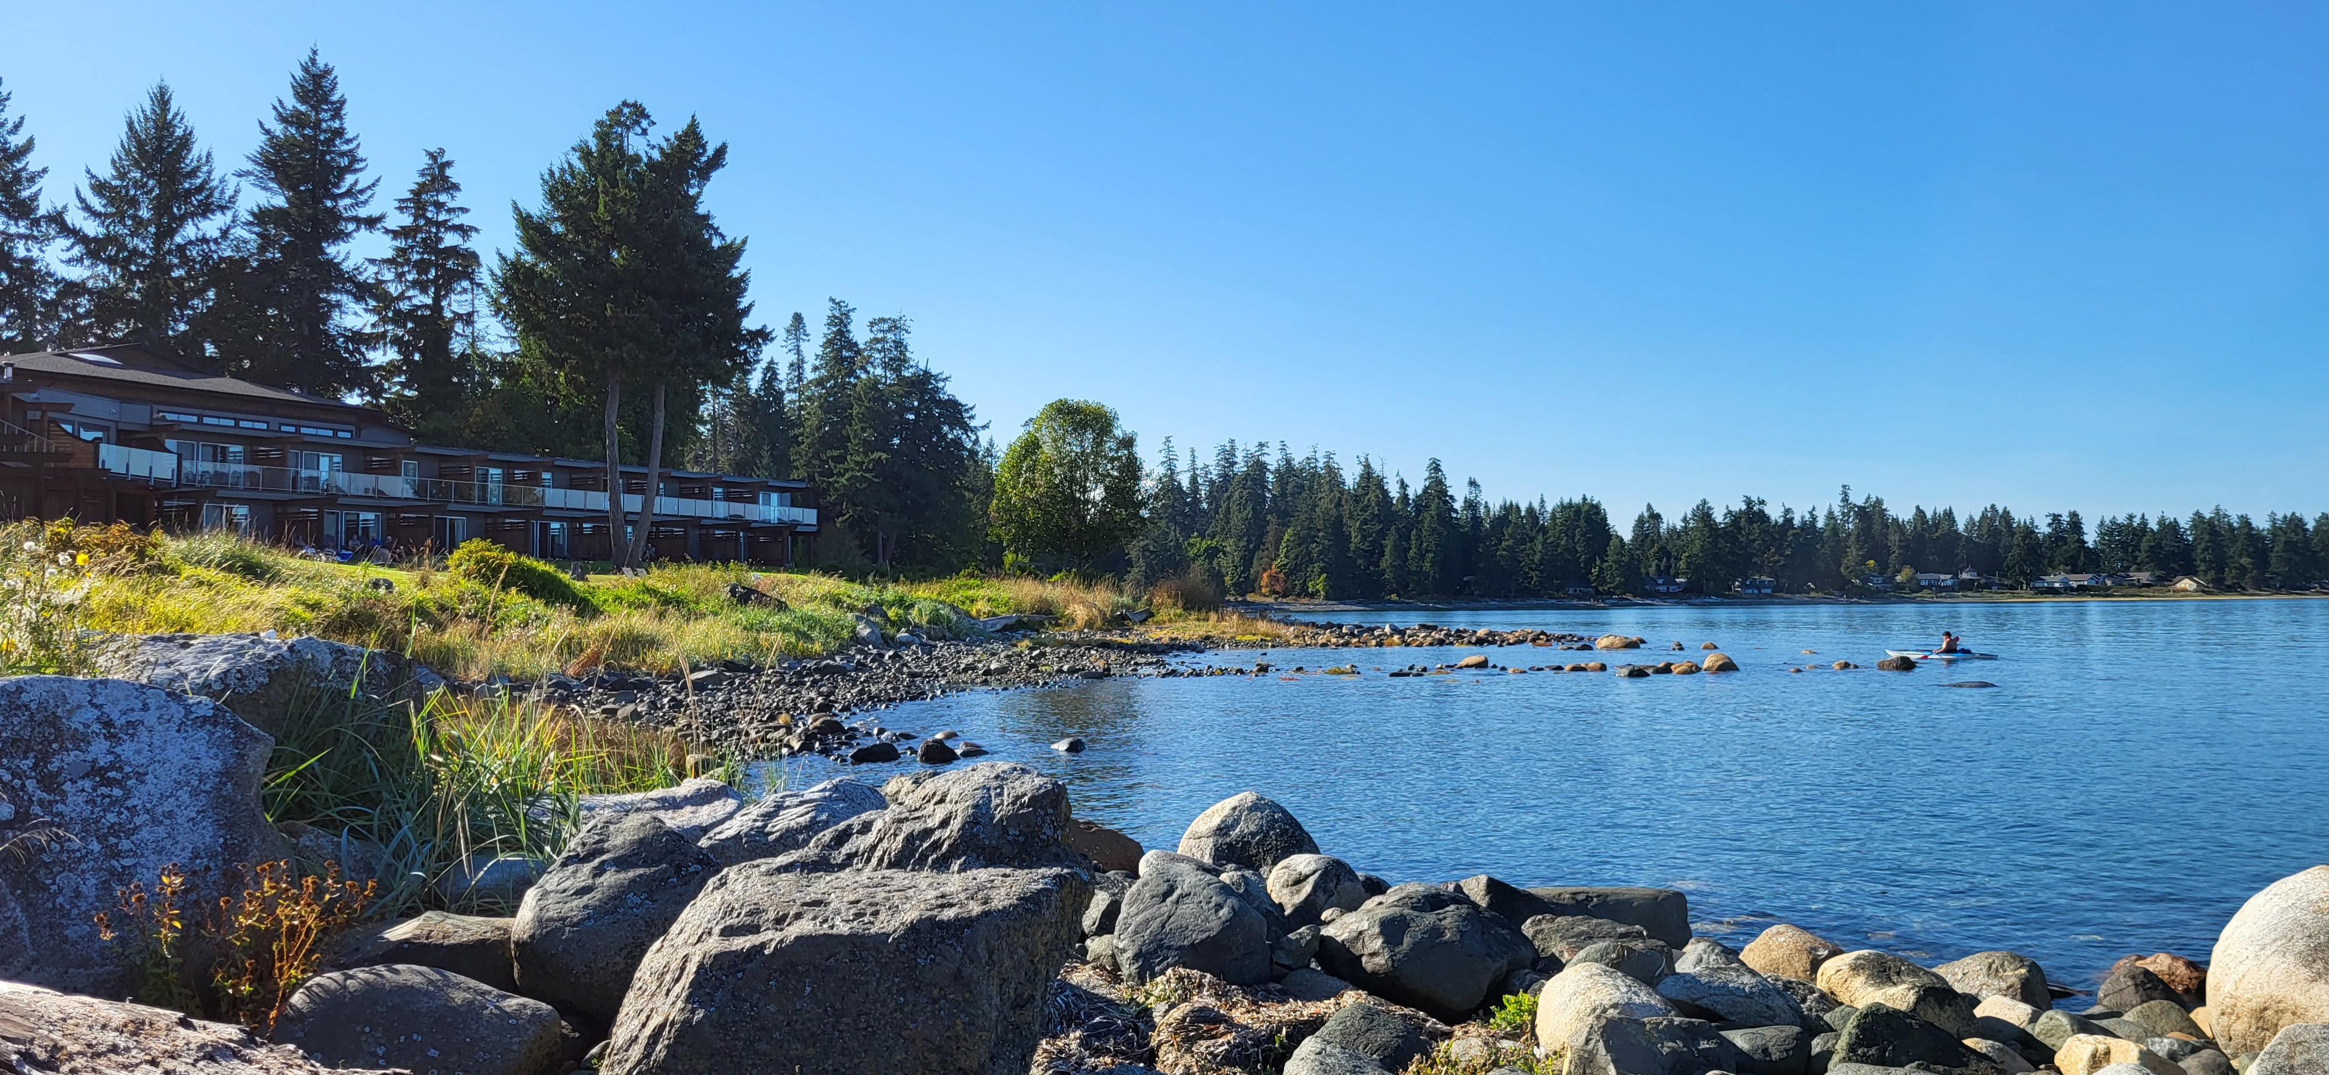
People
Places
Possibility
Notes:
So, what does this look like for you personally?
People: You are working in a team-first environment, building strong communication and leadership skills every day.
Places: You have the geographic flexibility to live and work in some of the most beautiful parts of BC.
Possibility: The growth opportunities here are flexible, fast-paced, and can take you further than you imagine.

Slide 5
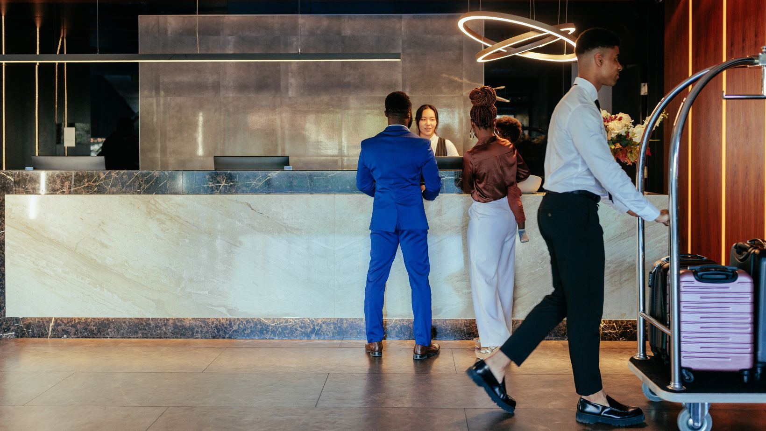

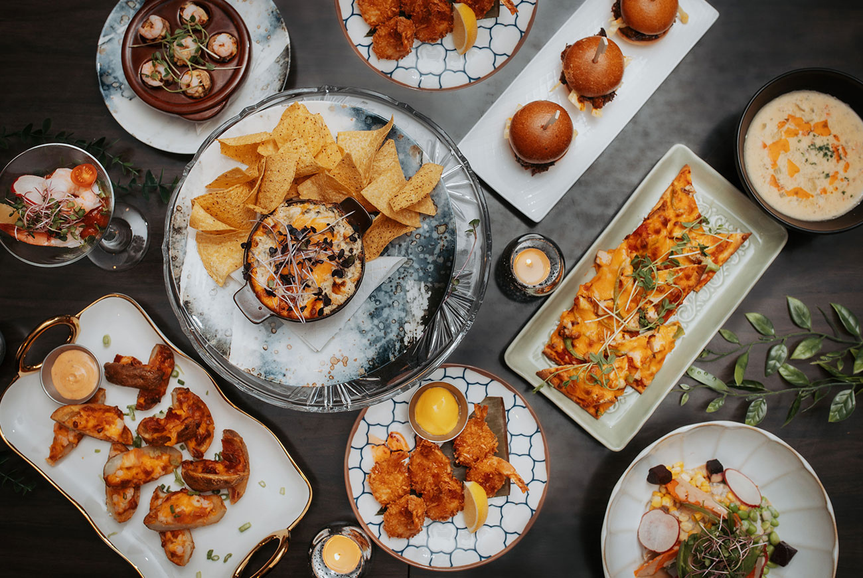
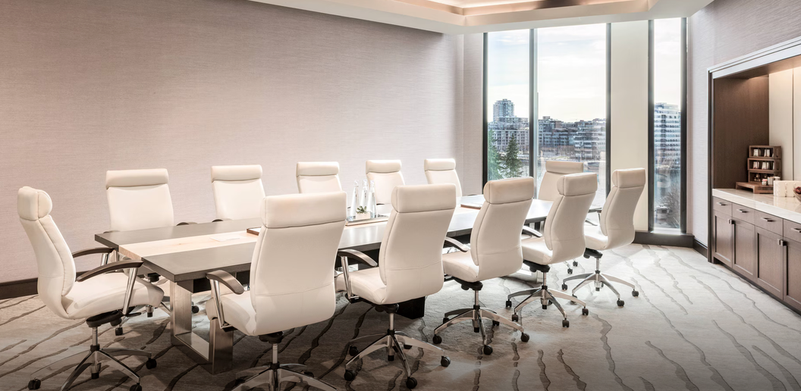
Front Office Manager
Executive Housekeeper
Supervisor
Front Office
Rooms & Divisions
Housekeeping Attendant
Guest Service Agent
TRADITIONAL CAREER PATHS
Restaurant
Manager
Director of Sales
Chef
Food & Beverage
Sales & Events
Event Coordinator
Server
Notes:
This chart shows the four traditional pillars of a hotel career, each with entry-level roles and promotion paths.
First, on the top left, we have the Front Office.
You can start as a Guest Service Agent, move up to a Supervisor, and eventually manage the entire department as a Front Office Manager.
On the top right is Rooms and Divisions.
This is the core of any hotel, where you can start as a Housekeeping Attendant and advance to Executive Housekeeper, managing large teams and inventory.
On the bottom left is Food and Beverage.
This covers everything from kitchen roles like Chefs to front-of-house roles like Servers and Restaurant Managers.
And on the bottom right is Sales and Events.
This is the corporate and revenue-driving side of the business, where you handle conferences, weddings, and corporate clients, moving from an Event Coordinator up to a Director of Sales.

Slide 6
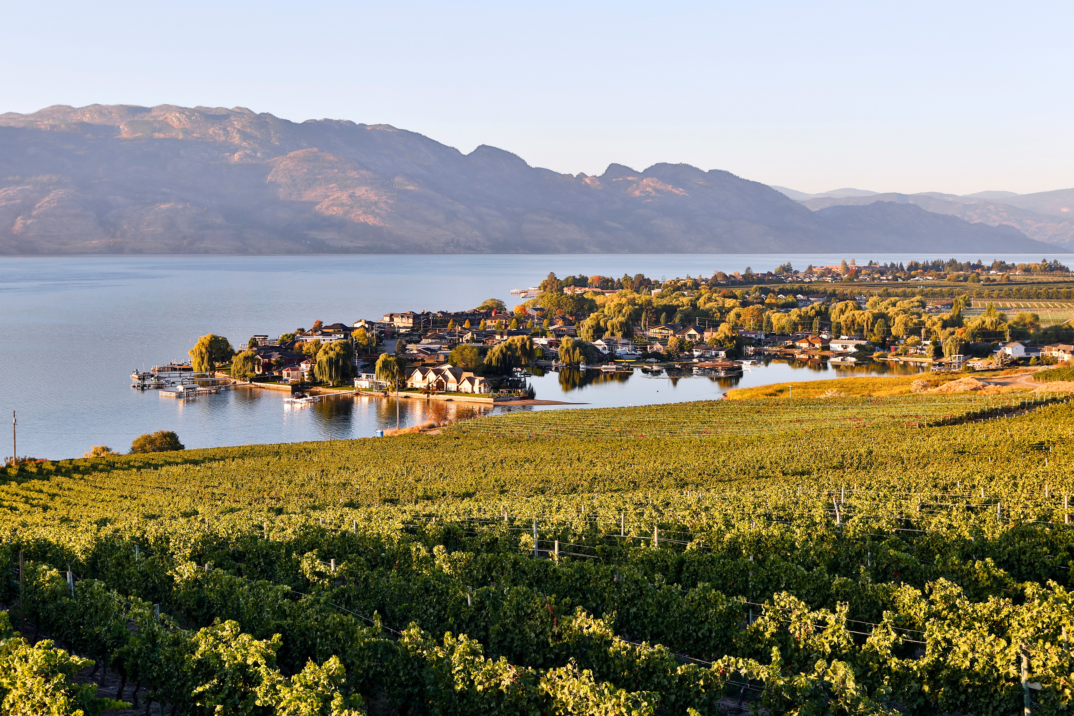





Career Path
Year
8-10
General Manager
Year
  Leads the entire property by overseeing all departments, strategy and finances
5
Department Head
Year
  Manages department, coordinates staff, budgets & performance
3
Supervisor
Year
  Oversee daily operations
  Ensure service standards are met
1
Guest Service Agent
  Provide excellent customer service
  Manage check-ins/outs
Notes:
This roadmap highlights how an individual can progress from entry-level operations to executive leadership.
It starts in Year 1 as a Guest Service Agent.
The primary focus here is mastering the fundamentals, such as providing excellent customer service and managing the daily flow of check-ins and check-outs.
This is where you build your foundation and truly understand the guest experience.
By Year 3, the focus shifts toward leadership as a Supervisor.
In this role, you step back from just handling individual transactions to overseeing daily operations as a whole.
You are also responsible for coaching the team and ensuring that your brand's service standards are consistently met.
Moving into Year 5 in a Department Head position.
Here, the scope of responsibility increases significantly.
You are managing the department staffing, budgets, and performance metrics.
By Years 8 to 10, you've reached a General Manager role. At this level, you lead the entire property.
This means overseeing all departments, driving the business strategy, and taking responsibility for the financial success of the hotel.
Ultimately, this timeline shows that with dedication and performance, the hospitality industry offers an excellent opportunity for professional development.

Slide 7

Lawyers
Sustainability
Specalists
Accountants
HR
Financial Controllers
CAREERS YOU MIGHT NOT EXPECT
Talent Development Leaders
Marketing
Outdoor Guides
Social Media Managers
Technology Roles
Revenue Managers
IT Roles
Notes:
When most people think of hotels, they think of front desk agents, housekeepers, or chefs.
But running a hotel is just like running any other big business. It requires a lot of different professional skills behind the scenes. Here are some careers in hospitality you might not expect.
On the left, we have the core business operations:
Lawyers handle contracts and legal compliance.
Accountants and Financial Controllers manage the money, budgets, and spending.
Marketing and Social Media Managers promote the property and bring in guests.
Revenue Managers use data to set room prices based on how busy we are.
On the right, we have roles focused on the property, the staff, and technology:
Sustainability Specialists work on green projects like reducing energy and waste.
HR and Talent Development Leaders focus on hiring, training, and helping staff grow their careers.
Outdoor Guides lead guest activities like hikes or tours at resort locations.
Technology and IT Roles keep the internet, booking systems, and computer networks running smoothly.
KEY MESSAGE: The main point here is that you don't just have to work at the front desk to be in hospitality.
Whether you are into math, law, creative work, or tech, there is a job for you in this industry.

Slide 8
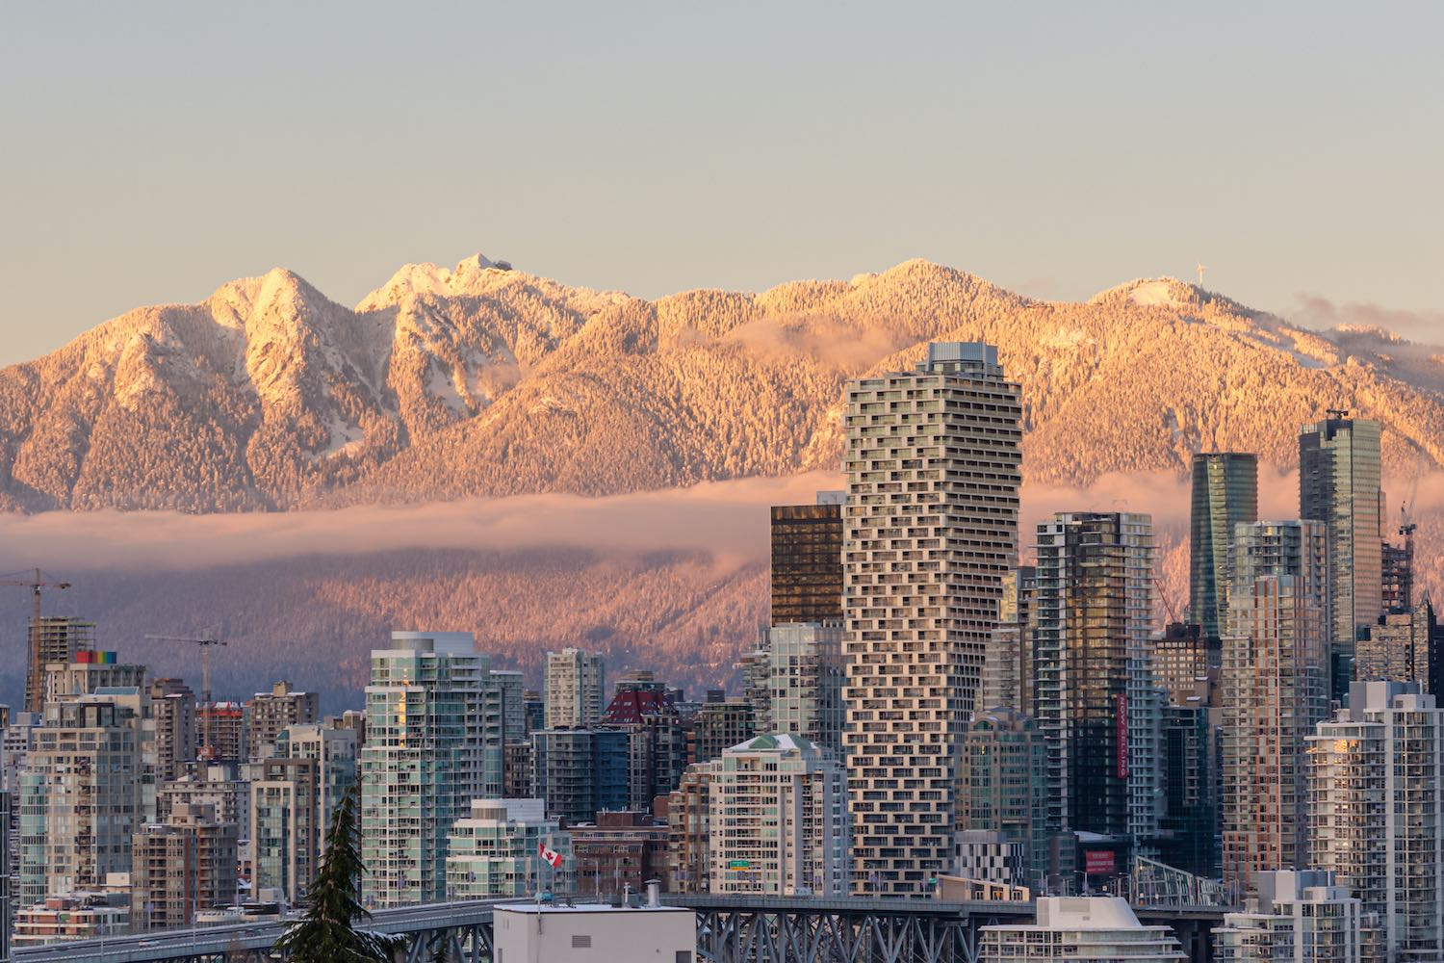
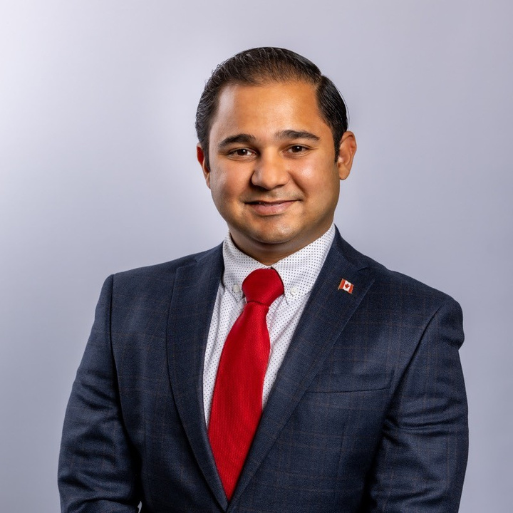
Career Journey
2014 – Entered the industry as a Steward at Delta Toronto
  Young Hotelier at Fairmont Pacific Rim
  Represented British Columbia at the Canadian EnTOURpreneur Experience
  Established the "Award of Excellence" at Ryerson University to support future hoteliers
  Recipient of the 2022 Top-30-Under-30 by Kostuch Media Ltd.
2024 – Operating Partner at Evergreen Hospitality Group
Karim Mohammadi
University degree in Hospitality & Tourism Management
Notes:
To show you what this growth looks like in real life, let’s look at the career story of Karim Mohammadi.
Karim graduated with a university degree in Hospitality and Tourism Management.
He started in 2014 working as a Steward at the Delta Toronto. For those who don't know, a steward handles kitchen cleanliness and dishwashing; it's a true entry-level role.
From there, he focused on building his skills and network:
He worked as a Young Hotelier at the Fairmont Pacific Rim.
He represented British Columbia at a national industry event called the Canadian EnTOURpreneur Experience.
He also wanted to give back, so he created the 'Award of Excellence' at Ryerson University to give financial support to future hotel students.
His hard work paid off. In 2022, he was named one of the Top 30 Under 30 by Kostuch Media, which is a major recognition in the Canadian hospitality sector.
By 2024, just ten years after starting as a kitchen steward, Karim became the Operating Partner at Evergreen Hospitality Group.
Karim’s story is a perfect example of what we just talked about. He started at the very bottom, worked hard, and in just a decade, he went from washing dishes to running a hospitality group.

Slide 9

Career Journey
2014 – Entered the industry as a Marketing Coordinator in Vancouver
  Sales Consultant at Flight Centre
  Sales & Marketing Manager at Best Western Premier Chateau Granville Hotel
  Led major initiatives: hotel rebrand, restaurant launch, and digital marketing campaigns
  Territory Manager with Globus Family of Brands, managing 200+ travel accounts across British Columbia
2025 – Director of Business Development at Surrey Hotel and Motel Association
Xenia Slosarick
University degree in Marketing Communications
Master's in Political Science
Notes:
Next, let’s look at Xenia Slosarick's career journey.
Xenia has a unique educational background, holding a university degree in Marketing Communications as well as a Master's degree in Political Science.
Her story shows how you can use a marketing background to grow into a senior leadership role.
She entered the industry here in 2014 as a Marketing Coordinator in Vancouver.
From there, she built up her experience in sales, marketing, and tourism:
She worked as a Sales Consultant at Flight Centre.
She then moved into hotel management as the Sales & Marketing Manager at the Best Western Premier Chateau Granville Hotel.
While there, she took on massive projects, including a full hotel rebrand, a new restaurant launch, and leading their digital marketing campaigns.
Next, she expanded her reach across the province as a Territory Manager for the Globus Family of Brands, where she managed more than 200 travel accounts throughout British Columbia.
In 2025, Xenia became the Director of Business Development at the Surrey Hotel and Motel Association.
Xenia’s path is a great example of how starting in a specialized role, like marketing coordinator, can lead to high-level leadership positions where you help shape the strategy for an entire region.

Slide 10
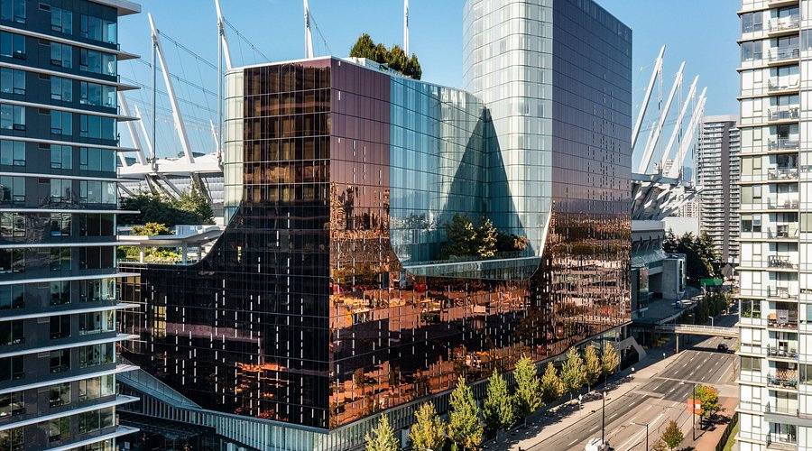

Let’s Hear it from our Hoteliers!
“I don’t really have a typical day, which makes it interesting.”
Raphael Dipasupil
Sales & Marketing Coordinator at JW Marriott Parq Vancouver & The Douglas Autograph Collection Hotel
Notes:
Now, let’s meet Raphael Dipasupil. Raphael is a great example of someone who has built experience in the fast-paced, creative side of the industry in Vancouver.
When we connected with Raphael, he was the Sales & Marketing Coordinator at JW Marriott Parq Vancouver and The Douglas.
It’s a unique role because he supported two different luxury hotel brands located within the same property.
Managing marketing for two distinct brands meant his work was incredibly diverse.
When we asked him what his schedule was like, he told us: “I don’t really have a typical day, which makes it interesting.”

Slide 11
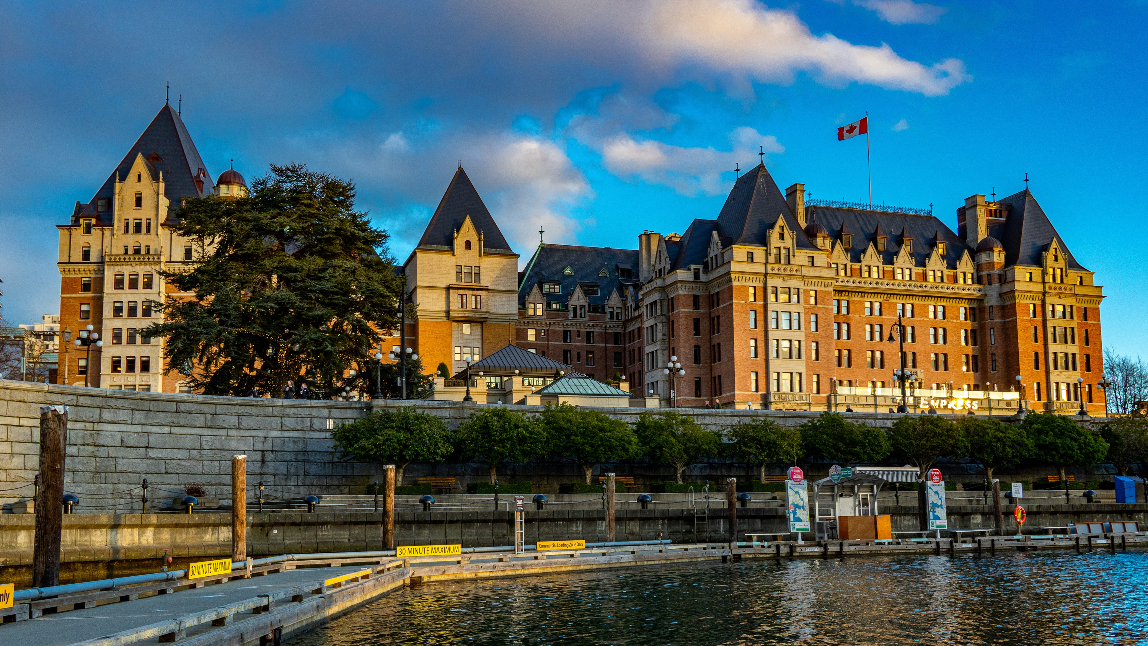

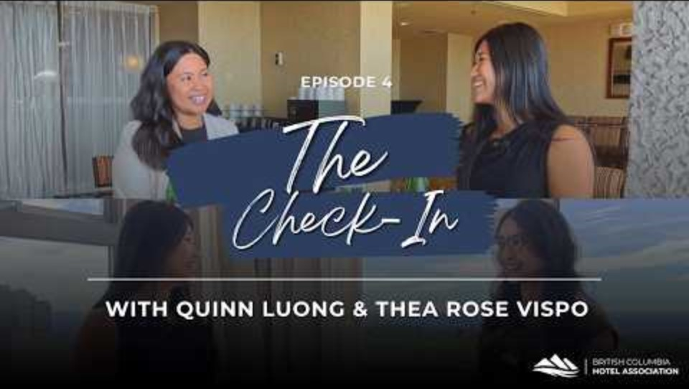

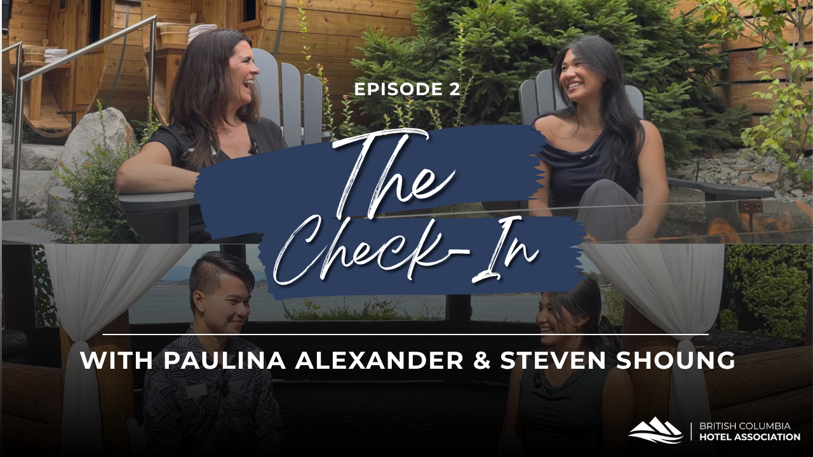

The Check-In | Hospitality Stories in BC
Notes:
If you’re curious about what it’s actually like to work in a hotel, BCHA’s The Check-In series gives you a chance to see it firsthand.
The series takes you inside hotels across BC to meet people working in different roles and hear how they got started in the industry.
Hosted by BCHA summer intern Ella Chow, The Check-In explores everything from housekeeping and sales to front desk, spa director, and GM roles, while also giving you a behind-the-scenes look at different hotel properties.
One of the things you’ll notice is that there isn’t one set path into hospitality. People come from different backgrounds, start in different roles and often discover opportunities they never expected.
If you’re interested in learning more about the industry after today, The Check-In is a great place to start.

Slide 12
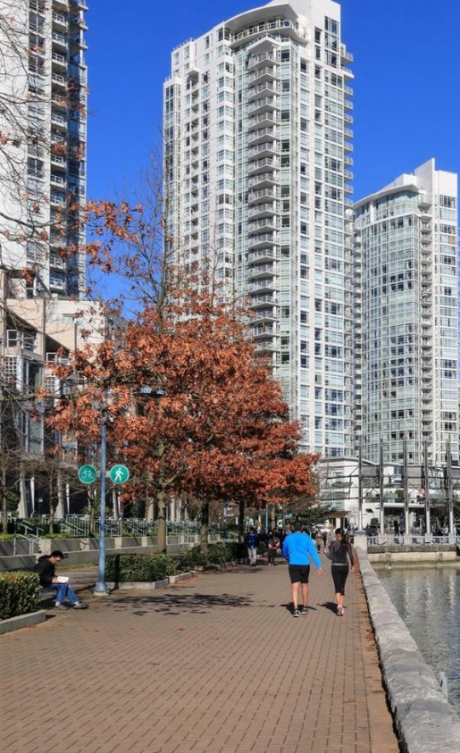

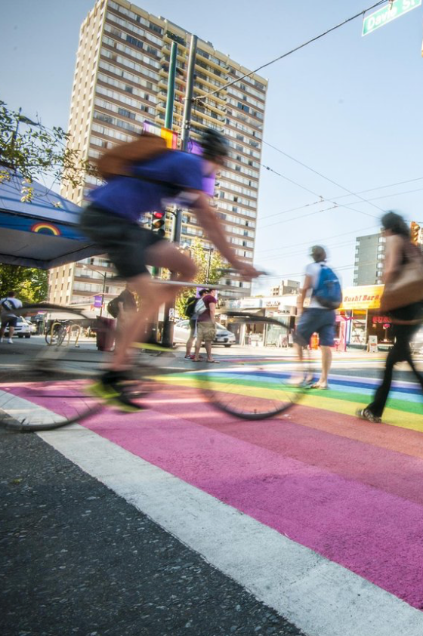


Lifestyle & Experience
Work in mountain towns, urban centres, or coastal resorts
Fast-paced, people-driven environment
Travel perks & hotel discounts
Seasonal flexibility
Team Culture
Notes:
One of the best parts of hospitality is that the lifestyle benefits are built right into how the industry operates, giving you a level of freedom you won't find at a traditional desk job.
Since hospitality is universal, your skills travel with you. You can build your career in an urban center like downtown Vancouver, move to the mountains like Whistler, or head out to a coastal resort on Vancouver Island.
The industry aligns with the seasons, offering incredible seasonal flexibility.
If you travel, you can use one of the industry's best perks: global hotel and travel discounts.
All of this happens within a people-driven team culture. It’s a collaborative environment where you are actively engaging with people every day.

Slide 13

Mentorship & Leadership Development
Leadership Development Programs
Hands-on Training Opportunities
Cross-Department Exposure
Industry Events & Conferences
Accessible Senior Leaders
Notes:
We’ve looked at how fast you can move up, but how does that actually happen?
This industry is designed to teach you as you go. It starts with hands-on training and getting you out to industry events and conferences where you can see the big picture.
It’s more than just learning your own job, though. We use cross-department exposure to let you experience how every part of the business connects.
For those who want to move into management quickly, we have formal Leadership Development Programs that act as a roadmap for your promotion.
What makes hospitality different from a typical office job is that hospitality leaders are visible and engaged.
In a hotel, the General Managers and Directors are on the floor with you every day. Since they are so accessible, they see your hard work in real-time.
They are mentors who are available to give you advice or feedback. When the people at the top are that involved, your potential gets noticed a lot faster.

Slide 14


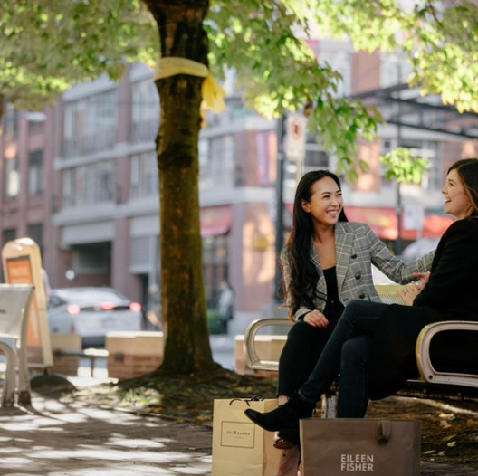
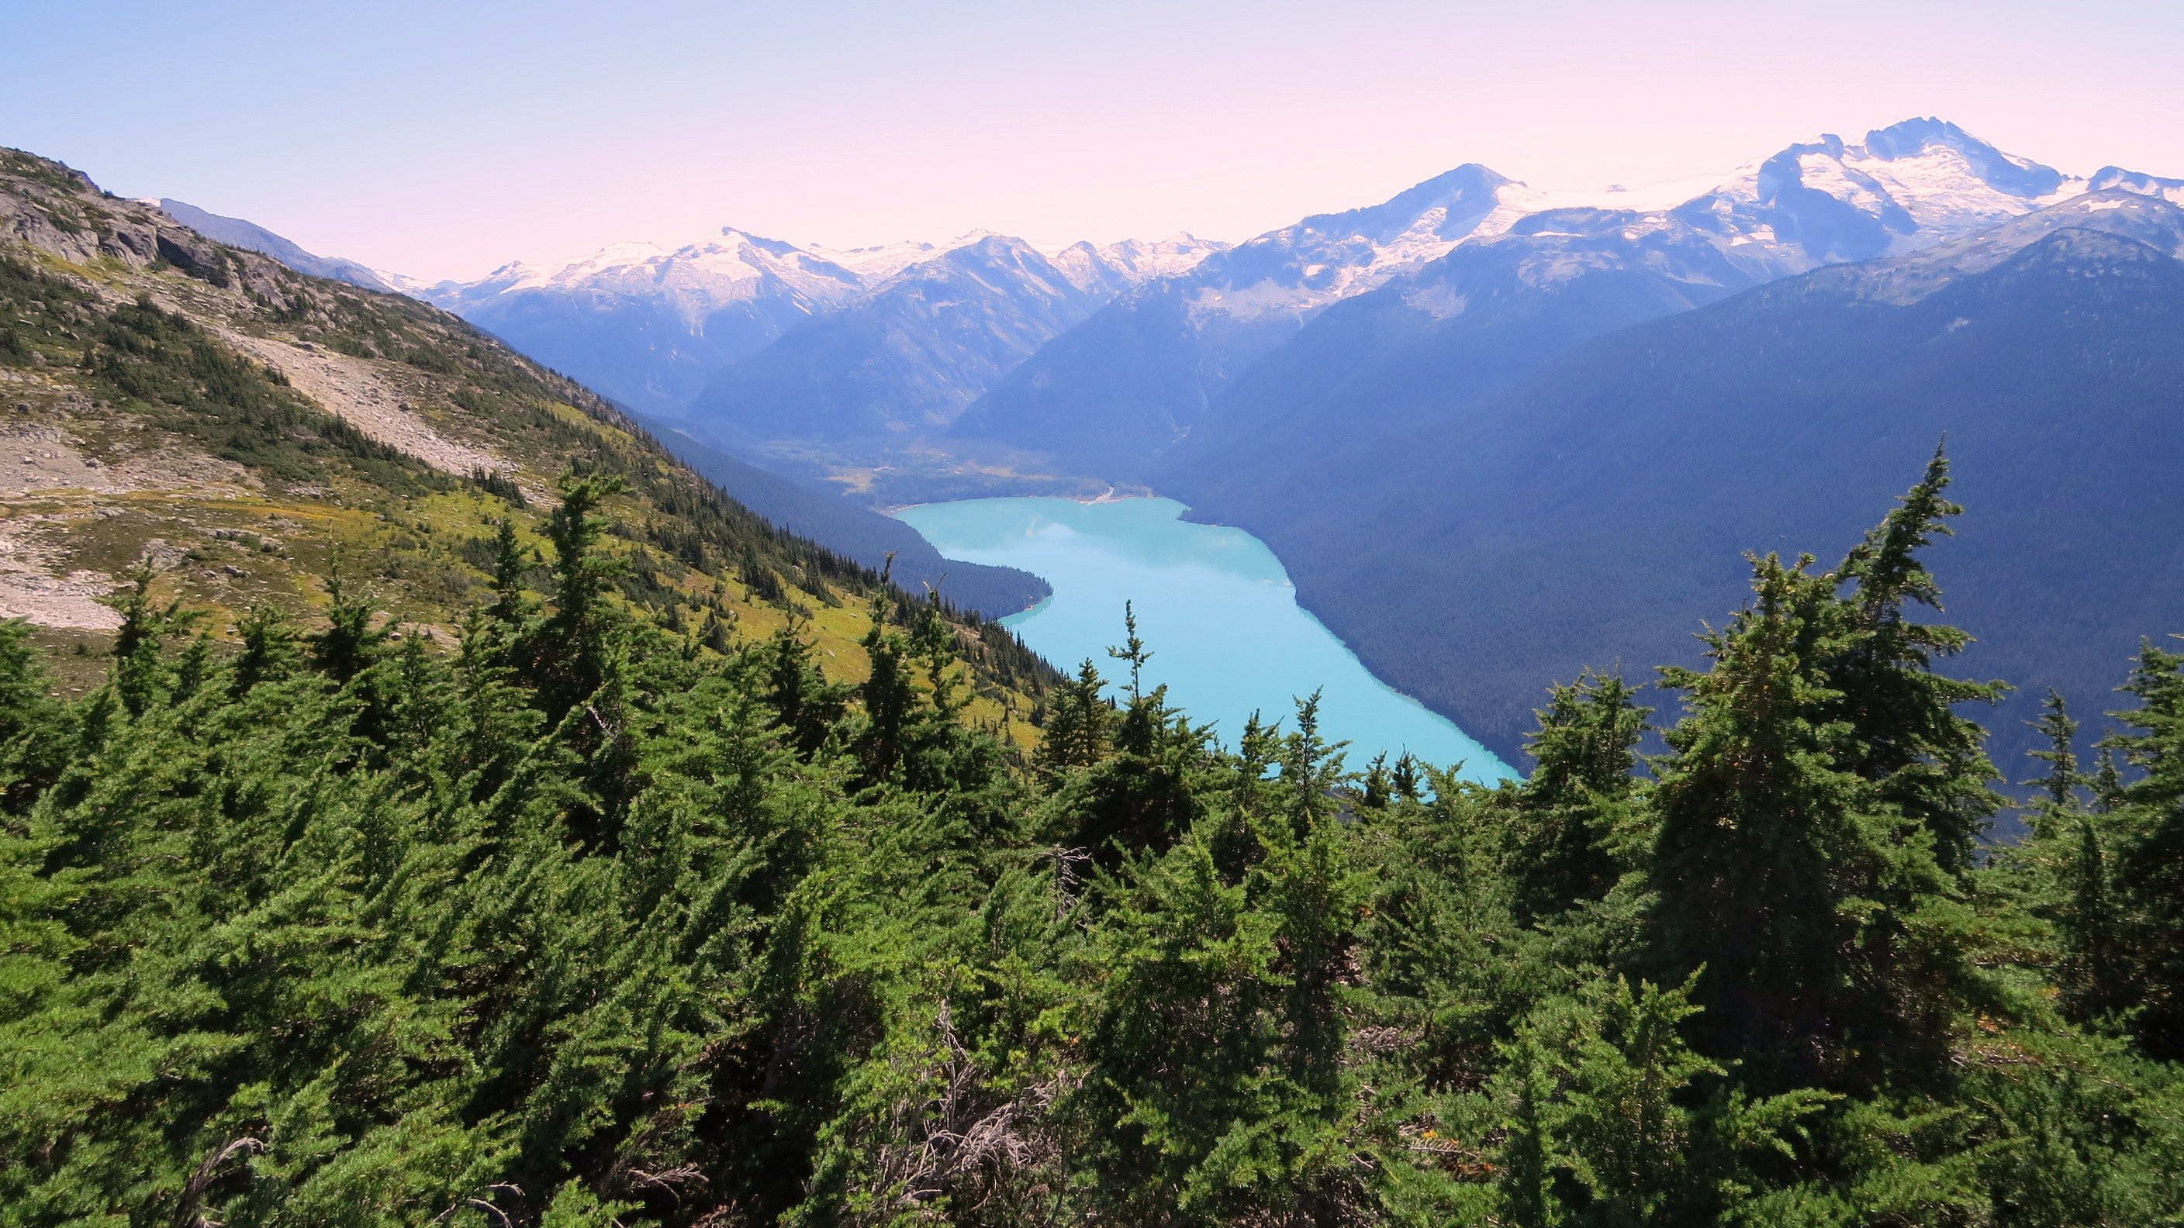
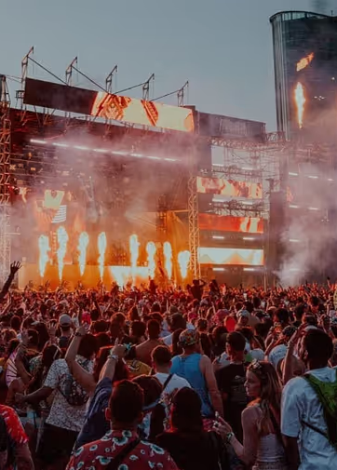

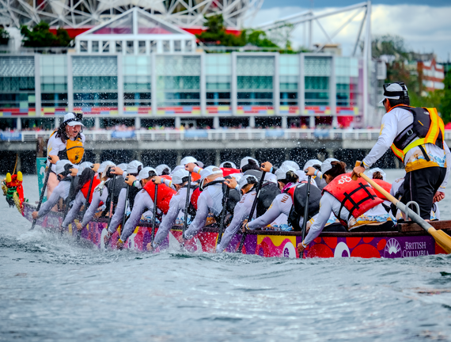
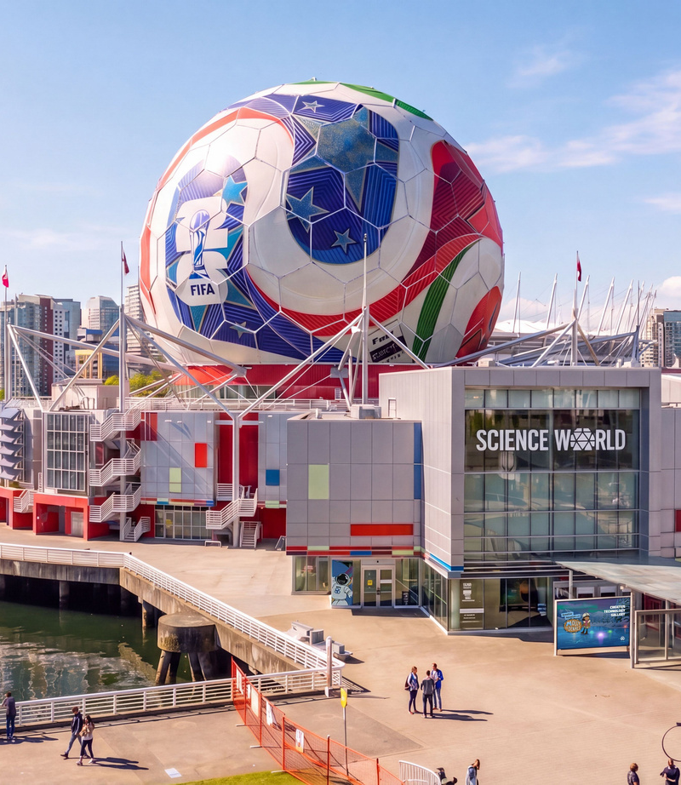



Global Stage
  2026 FIFA World Cup
  Crankworx Whistler
  Shambhala Music Festival
  FVDED in the Park
  Vancouver International Film Festival
  Canadian International Dragon Boat Festival
  BC Summer Games
  2027 Fan Expo Vancouver
Notes:
BC is a world-class destination that constantly hosts major international sporting events, massive music festivals, and global cultural exhibitions.
Vancouver was a host city for the 2026 FIFA World Cup, which brought the global spotlight right to Vancouver.
BC communities host world-famous events like Crankworx Whistler for mountain biking, the Canadian International Dragon Boat Festival, and the BC Summer Games.
We have massive music festivals that draw crowds from all over, like Shambhala Music Festival and FVDED in the Park.
On the cultural side, events like the Vancouver International Film Festival and the upcoming 2027 Fan Expo Vancouver bring in massive crowds of creators and fans.
What does this mean for you? It means our industry is always buzzing.
Every event relies on hospitality. They need teams to manage hotel accommodations, coordinate massive food and beverage operations, run event logistics, and guide international guests around our city.
When you work here, you get hands-on experience helping execute some of the biggest entertainment and sporting events in BC.

Slide 15
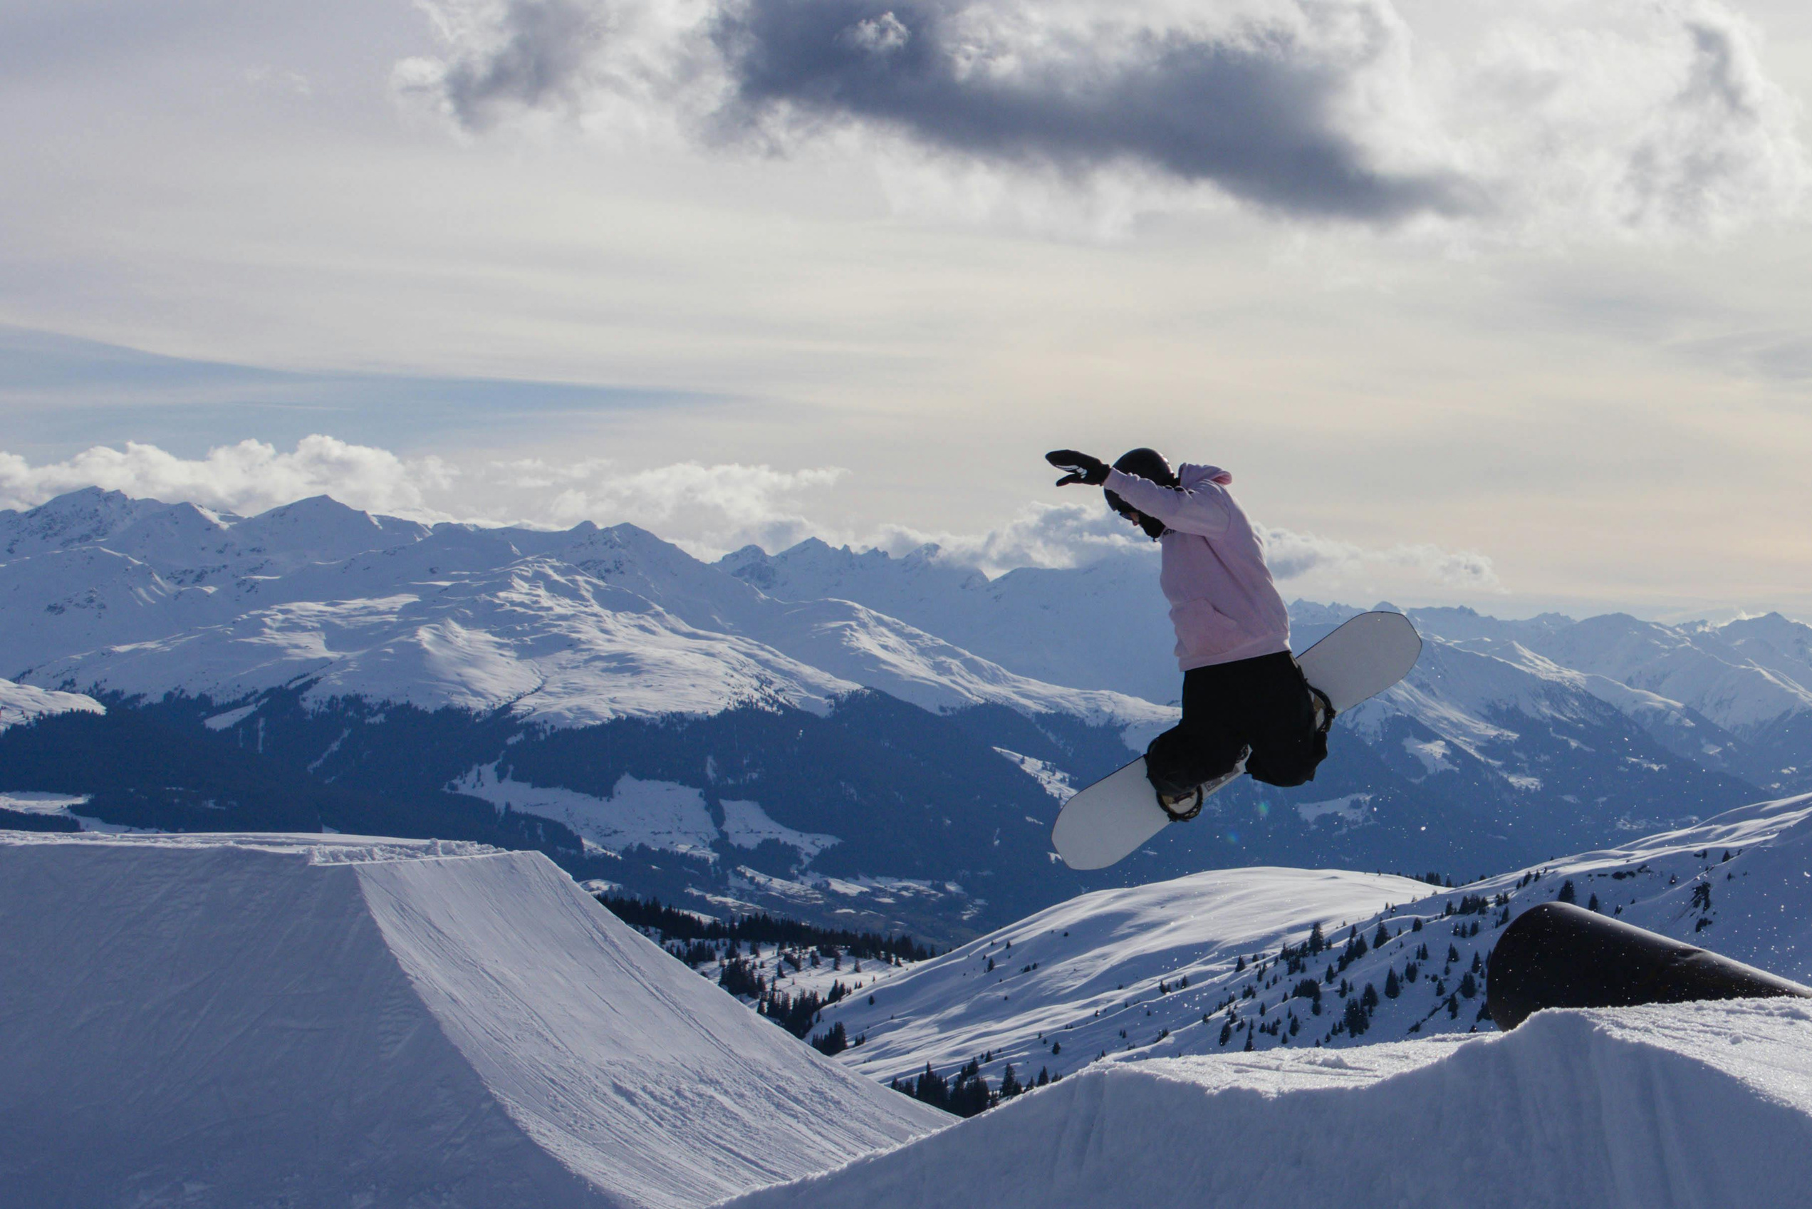
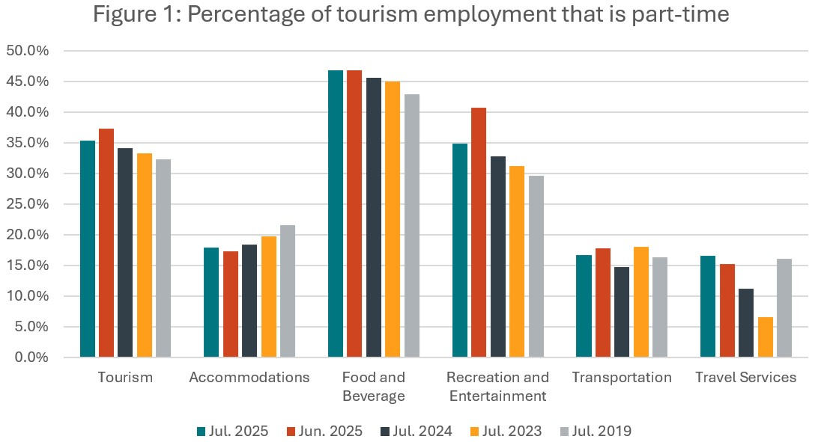
Earn While You Learn
Paid Entry-Level Work
$28
/hr Industry Average
BC’s minimum wage as of June 1, 2026 is $18.25 per hour.
Youth Tourism Workforce
27%
of workers are aged 15-24
More than double the Canadian industry standard for youth workers.
Student-Compatible Hours
71%
of youth roles are part-time
Build your career around you, not the other way around.
TourismHR.ca | go2HR.ca
Notes:
One of the best things about this industry is that it is built for students and young professionals.
You don't need a massive resume to get started; as we like to say, you don’t need experience to get experience!
Let's look at what the data tells us about working in BC tourism and hospitality.
The industry average for paid, entry-level work is $28 an hour.
To put that in perspective, that is significantly higher than BC's minimum wage, which just increased to $18.25 an hour as of June 1st. You are earning a highly competitive wage right from day one.
Because the industry is so welcoming to newcomers, it has become a hub for young workers.
Right now, 27% of the tourism workforce is made up of youth aged 15 to 24. That is more than double the standard Canadian industry average.
It is a vibrant environment where you are working alongside peers.
The data also shows how easy it is to balance work with school or other commitments.
If you look at the chart on the left, it breaks down the percentage of part-time jobs across different sectors like food and beverage, accommodations, and recreation.
Overall, 71% of youth roles in tourism are part-time. This means you can easily build your career around your class schedule.
While AI and automation are changing many industries, AI won't replace tourism jobs.
Technology handles the repetitive, routine administrative tasks behind the scenes. What it can't replace is human connection.
Automation actually frees up our staff to focus entirely on what matters most: creating great, memorable experiences for our guests.
Ultimately, this industry offers great pay, maximum flexibility for students, and a secure future where human skills are always valued.

Slide 16










Education Pathways
Notes:
BC has an amazing network of educational institutions offering paths tailored to exactly how you want to learn.
If you are looking for dedicated degrees and specialized business programs in Metro Vancouver, Acsenda School of Management and Fairleigh Dickinson University both offer Bachelor of Hospitality Management degrees, alongside Business Administration paths.
Capilano University features a full Bachelor of Tourism Management and flexible international diplomas.
Royal Roads University provides degree and certificate paths specifically built around tourism and hospitality management.
If you want a blend of business management and operational or culinary skills, Vancouver Community College offers a Bachelor of Hospitality Management, but also respected technical programs like Asian Culinary Arts and professional cooking certifications.
Western Community College offers everything from full degrees to rapid food service assistant certificates to get you into the workforce quickly.
If you look at universities in other regions of BC:
Okanagan College offers Business Administration and individualized studies.
Kootenay Columbia College provides great options in tourism management as well as accounting and payroll administration.
Excel Career College offers flexible hospitality diplomas and financial office assistant certificates.
The main takeaway across almost all of these institutions is their focus on Co-Op and Work-Integrated Learning.
These schools partner directly with local employers. This means you are gaining paid, real-world experience that counts toward your graduation and builds your resume.

Slide 17

Learn with us, keep these skills forever.
Leadership
Crisis Management
Cultural Intelligence
Guiding teams to deliver excellent guest experiences and achieve operational goals.
Responding calmly and efficiently to emergencies or unexpected challenges in operations.
Respecting and adapting to diverse guests, staff, and cultural expectations.
Communication
Financial Understanding
Entrepreneurial Thinking
Clear, effective interaction with guests, staff, and stakeholders in diverse situations.
Innovating and seizing opportunities to improve services and business outcomes.
Managing budgets, costs, and revenue to ensure profitable hospitality operations.
Notes:
To wrap things up, we want to discuss the key takeaway from working in hospitality.
Let’s look at the first three skills on top:
Leadership: You learn how to guide a team, keep everyone focused on delivering great customer experiences, and meet daily business goals.
Crisis Management: Things don't always go according to plan in a live environment. You learn how to stay calm and solve emergencies or unexpected challenges quickly and efficiently.
Cultural Intelligence: Hotels bring together people from all over the world. You learn how to respect, communicate with, and adapt to guests and coworkers from completely different backgrounds and cultures.
The next three skills focus on business fundamentals:
Communication: You practice clear and effective speaking and writing every day, whether you are talking to a guest, your staff, or company stakeholders.
Financial Understanding: You gain practical experience handling budgets, controlling costs, and finding ways to be profitable.
Entrepreneurial Thinking: You learn to look for opportunities to innovate, improve everyday services, and drive better results.
Working with us means building a foundation that will set you up for success in any industry you choose.

Slide 18

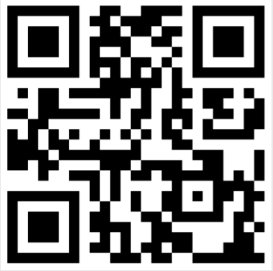
Your First Step!
+ Q&A
  Apply for a summer job or Co-Op
  Job Shadow
  Connect with local hotels
VISIT THE BCHA WEBSITE FOR MORE INFORMATION!

